Slide 1


Challenges and Opportunities in the Internet of Things
Martin Carlisle
Director of Academic Affairs and Teaching Professor

Slide 2

What is It?
A network of physical devices embedded with software, sensors, actuators and the data processing that facilitates it.
Cloud – software and services in data centers
Fog ¹ – horizontal physical or virtual resources between smart end devices and the cloud
Mist – an (optional) lightweight fog layer
Edge – network layer of smart end-devices and users
¹ “The NIST Fog Computing Definition” https://csrc.nist.gov/csrc/media/publications/sp/800-191/draft/documents/sp800-191-draft.pdf
Image from: https://ayehu.com/how-the-internet-of-things-will-complicate-incident-response/
Notes:
Fog - This paradigm supports vertically-isolated, latency-sensitive applications by providing ubiquitous, scalable, layered, federated, and distributed computing, storage, and network connectivity.

Slide 3
What makes it unique?
Geographical distribution
  Location awareness
  Mobility
Very large number of nodes
Heterogeneity
Interoperability/federation
Cyber-physical interactions
Real-time analytics

Slide 4
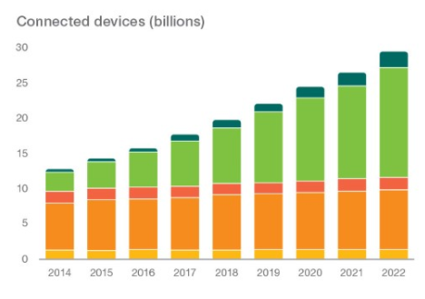
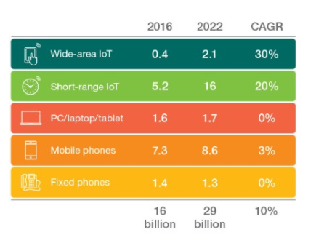
How big?
Ericsson forecast =>
Wide Area includes cell phone, plus unlicensed low-power (Sigfox, LoRa, Ingenu)
Short range – unlicensed radio up to 100m (e.g. Wi-Fi, Bluetooth, Zigbee) plus wired
Images from: https://www.ericsson.com/en/mobility-report/internet-of-things-forecast
Notes:
The short-range segment consists of devices connected by unlicensed radio with a typical range of up to around 100 meters, such as Wi-Fi, Bluetooth and ZigBee. This category also includes devices connected over fixed line local area connections.
The wide-area category consists of devices using cellular connections (3GPP-based with some CDMA), as well as unlicensed low-power technologies, such as Sigfox, LoRa and Ingenu.

Slide 5
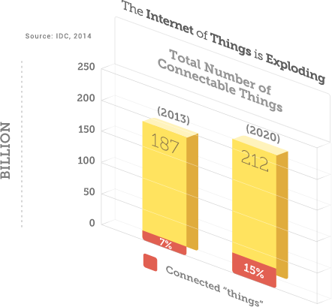
How big?
There’s a vast number of connectable things, and the number that are being connected is growing rapidly.
Image from: https://www.emc.com/leadership/digital-universe/2014iview/internet-of-things.htm
Notes:
“Of course, not all of those 200 billion things are actually wired and communicating on the Internet, but some 20 billion are. And, by 2020, this number will grow by 50% to 30 billion connected devices.” EMC.

Slide 6
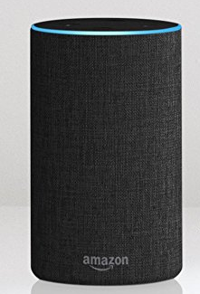
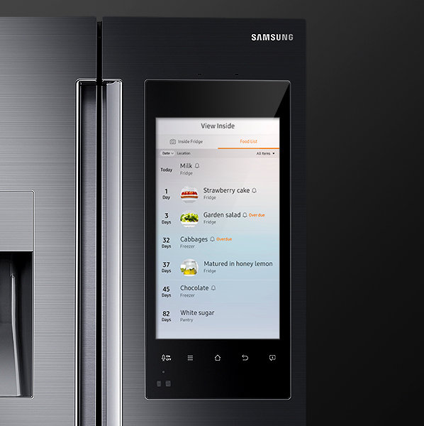
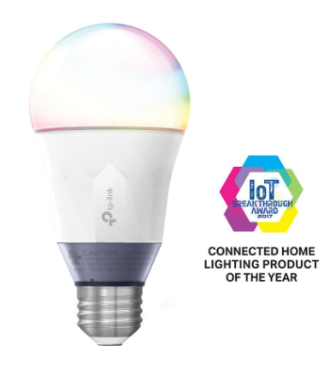
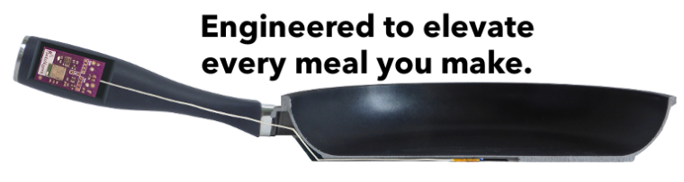
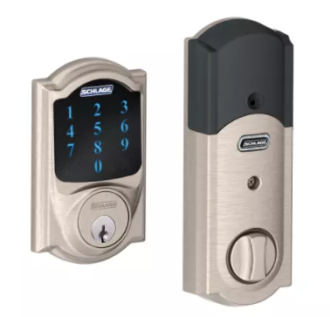
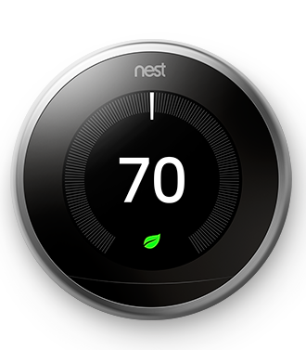
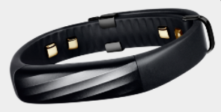

What might you have today?
Notes:
https://www.samsung.com/us/explore/family-hub-refrigerator/connected-hub/-- they also have an oven!
Amazon echo
Can integrate your fitness band to your smart things so when you wake up it turns on the coffee!

Slide 7
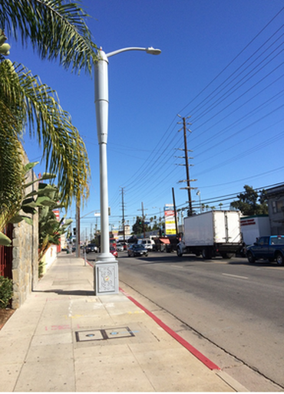
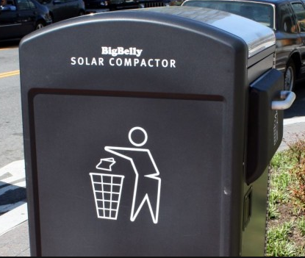
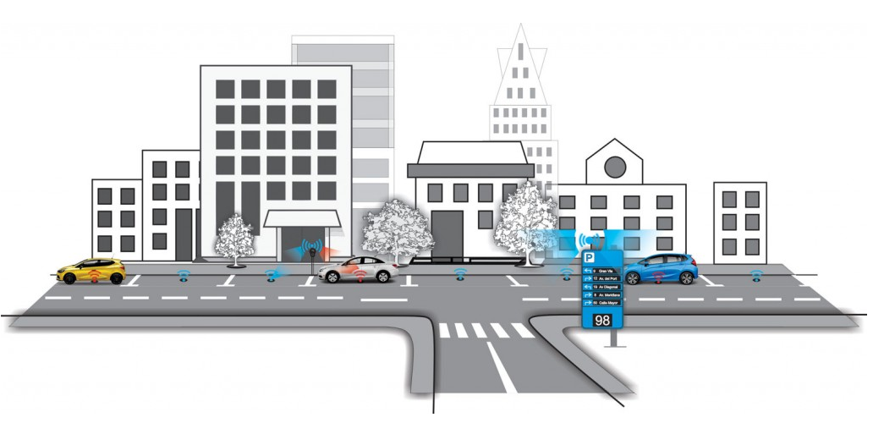
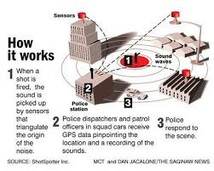
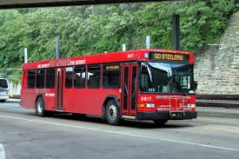
And on the town
Notes:
Smart streetlights brighten when multiple people around and dim when no one is in area (joke about bathroom sensor light)

Slide 8
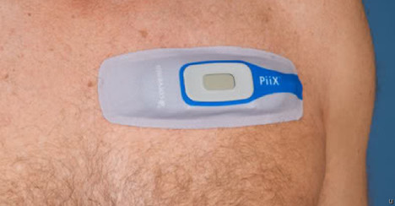
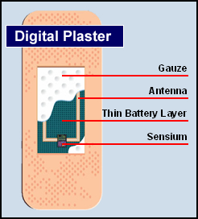
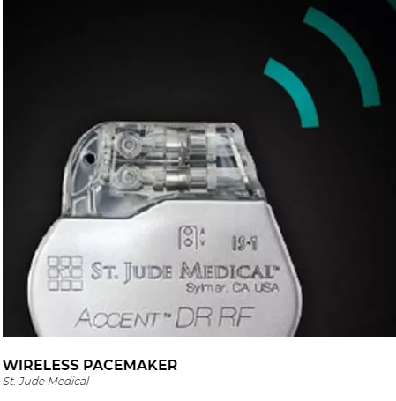
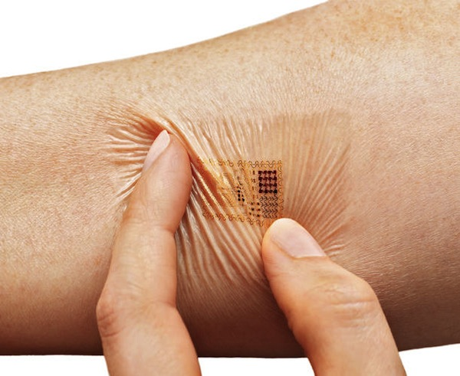
Medical IoT
Notes:
The ‘Biostamp’ is a clever adhesive device that is thinner than a band-aid and the size of two postage stamps, which can be pasted onto any part of the body to “monitor temperature, movement, heart rate and more, and transmit this data wirelessly back to patients and their clinicians”.

Slide 9
Imagine the Future
What does this mean for
  Health
  Shopping
  Transportation
  Entertainment
  Energy
  Agriculture
  Manufacturing
  …?
Notes:
http://www.businessinsider.com/iot-transforms-industries-2016-10/#manufacturing-6

Slide 10
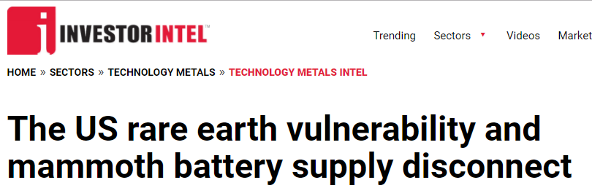
How do we power it?
Energy harvesting?
  Piezeoelectric materials
  Photovoltaic
  Thermal
Batteries?
https://investorintel.com/sectors/technology-metals/technology-metals-intel/us-vulnerability-mammoth-battery-disconnect-rare-earth-supply/
Notes:
https://investorintel.com/sectors/technology-metals/technology-metals-intel/us-vulnerability-mammoth-battery-disconnect-rare-earth-supply/

Slide 11
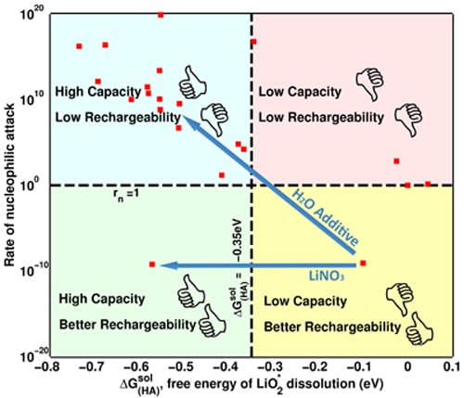
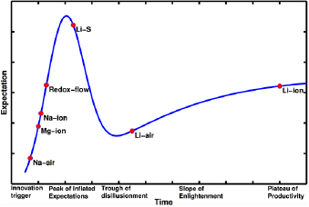
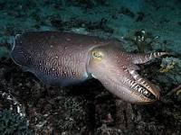
Carnegie Mellon Battery Research
Lithium Air Batteries (Venkat Viswanathan)
Biodegradeable batteries from cuttlefish ink (Bettinger and Whitacre)
https://www.cmu.edu/news/stories/archives/2015/july/lithium-air-batteries.html
http://iopscience.iop.org/article/10.1088/2053-1613/2/4/045002/meta

Slide 12
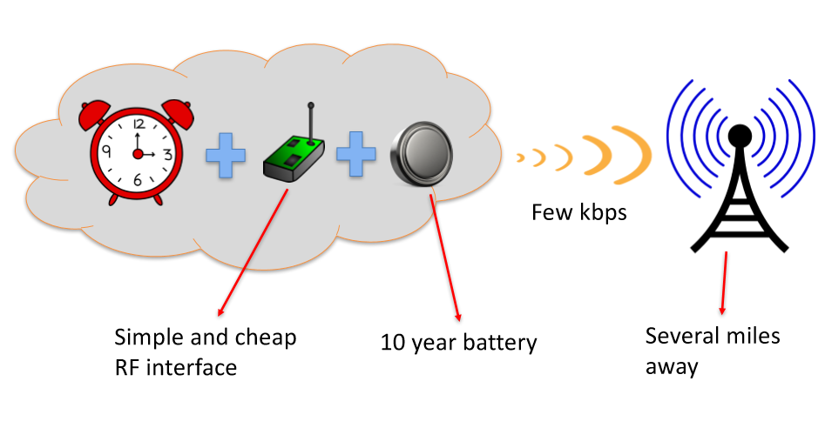
How can they all talk? - CHOIR
SIGCOMM 2017 – Carnegie Mellon paper by Diana Zhang, Swarun Kumar and Osman Yagan
http://conferences.sigcomm.org/sigcomm/2017/files/program/ts-8-1-choir.pdf

Slide 13
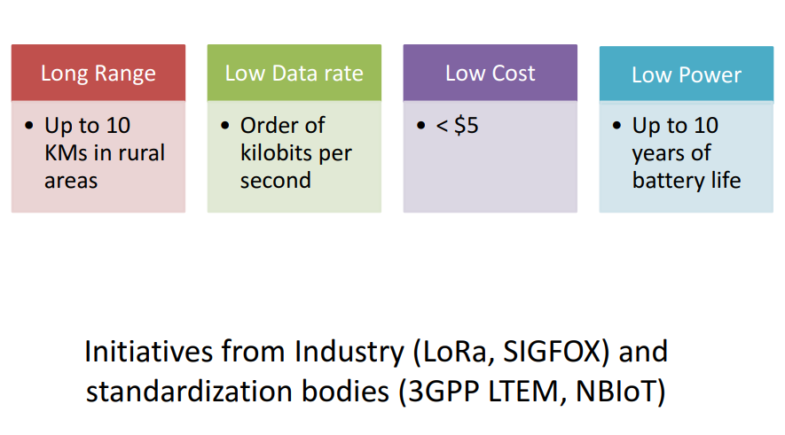
LP-WAN
http://conferences.sigcomm.org/sigcomm/2017/files/program/ts-8-1-choir.pdf

Slide 14
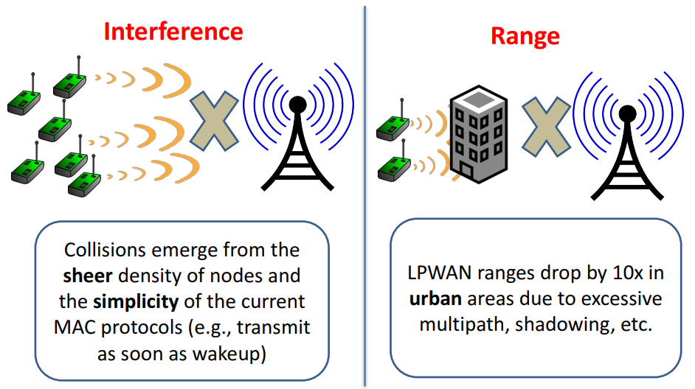
Key Challenges
http://conferences.sigcomm.org/sigcomm/2017/files/program/ts-8-1-choir.pdf

Slide 15
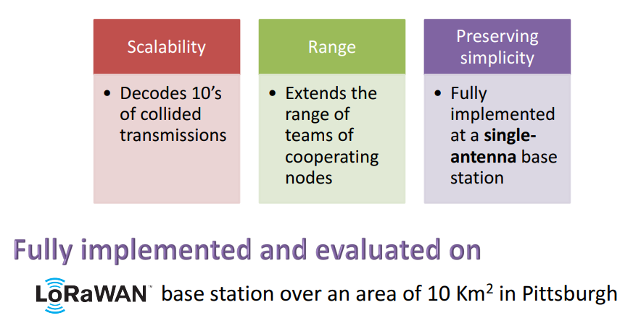
Choir
http://conferences.sigcomm.org/sigcomm/2017/files/program/ts-8-1-choir.pdf

Slide 16
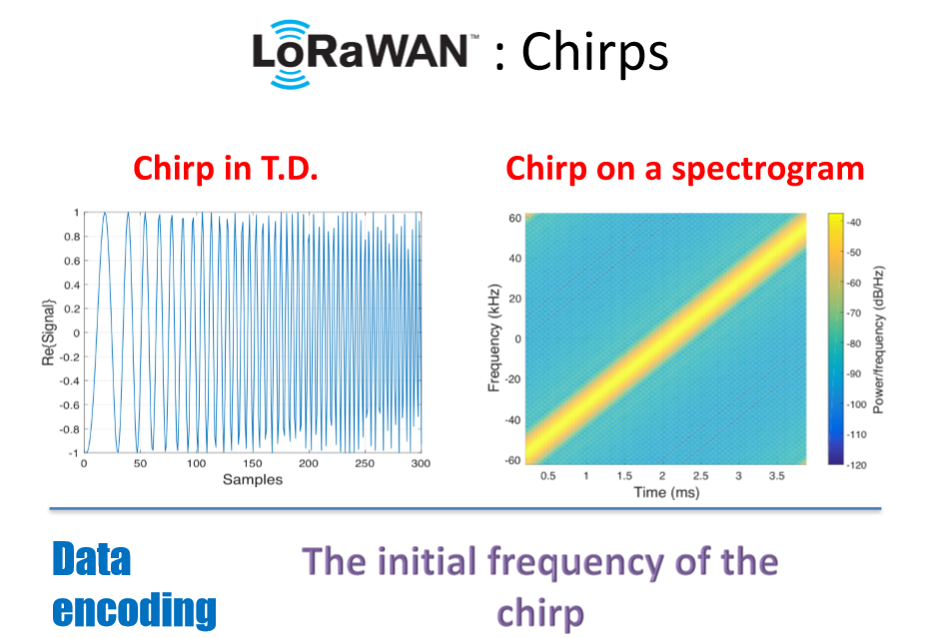
Choir
http://conferences.sigcomm.org/sigcomm/2017/files/program/ts-8-1-choir.pdf

Slide 17
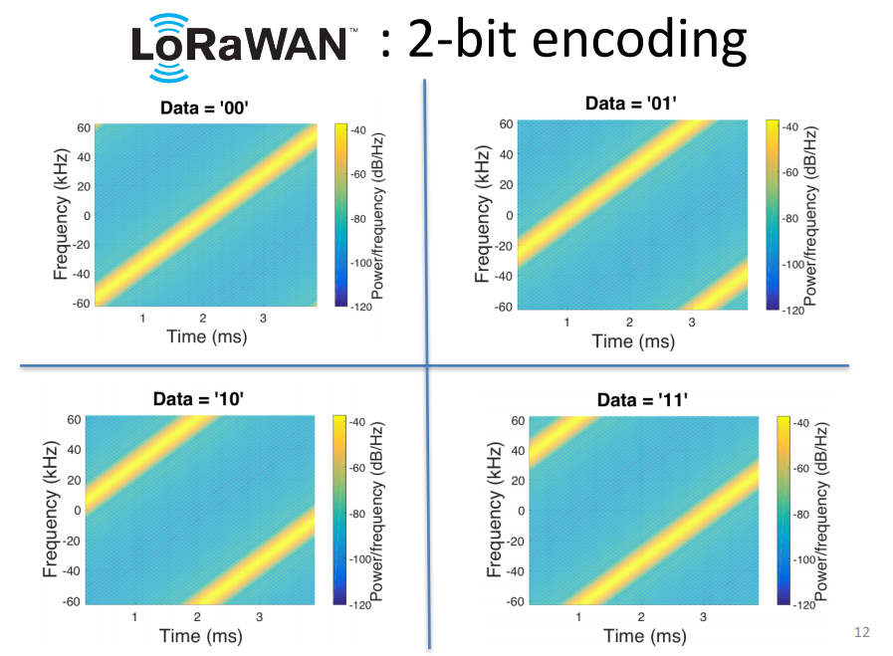
Choir
http://conferences.sigcomm.org/sigcomm/2017/files/program/ts-8-1-choir.pdf

Slide 18
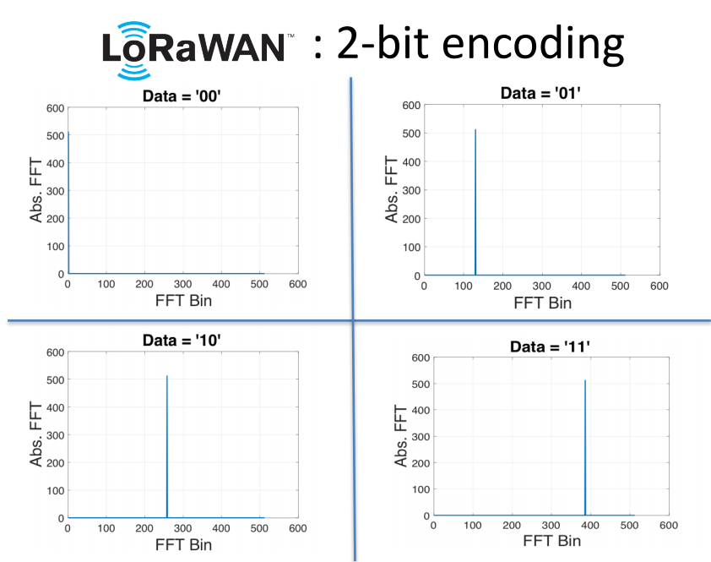
Choir
http://conferences.sigcomm.org/sigcomm/2017/files/program/ts-8-1-choir.pdf

Slide 19
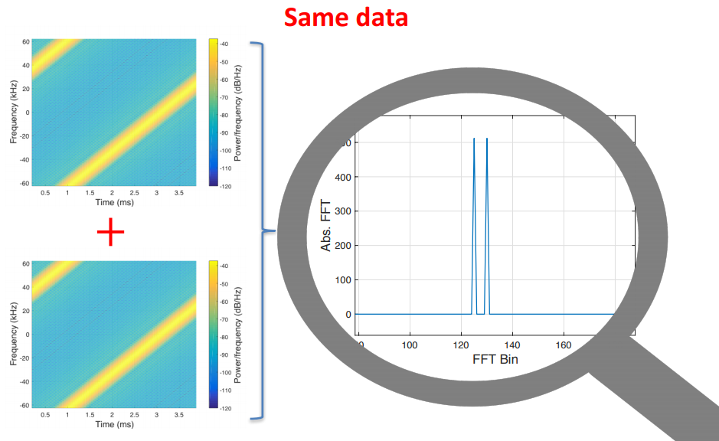
Choir – Resolving collisions
http://conferences.sigcomm.org/sigcomm/2017/files/program/ts-8-1-choir.pdf

Slide 20

Choir – Resolving collisions
Because these are cheap devices, they have mismatches in their oscillators
http://conferences.sigcomm.org/sigcomm/2017/files/program/ts-8-1-choir.pdf

Slide 21
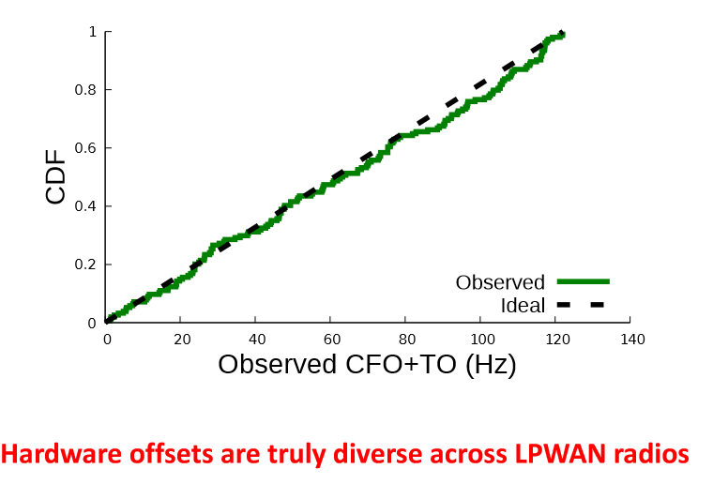
Choir
http://conferences.sigcomm.org/sigcomm/2017/files/program/ts-8-1-choir.pdf

Slide 22
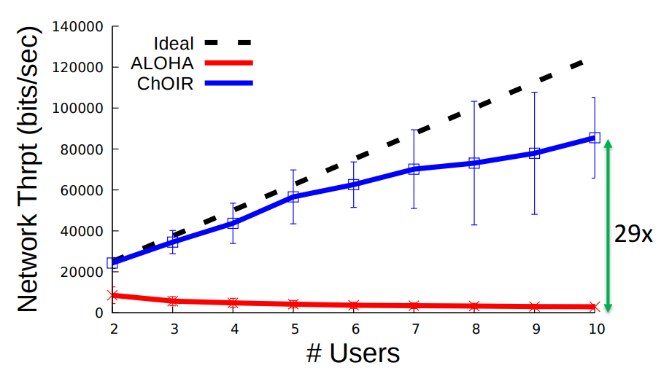
Choir – Resolving Inteference
http://conferences.sigcomm.org/sigcomm/2017/files/program/ts-8-1-choir.pdf
Notes:
The version of the protocol (now called "Pure ALOHA", and the one implemented in ALOHAnet) was quite simple:
If you have data to send, send the data
If, while you are transmitting data, you receive any data from another station, there has been a message collision. All transmitting stations will need to try resending "later".

Slide 23
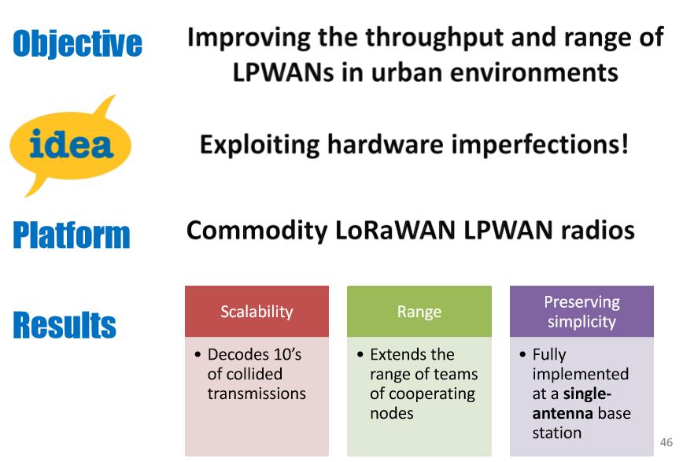
Choir - Conclusion
http://conferences.sigcomm.org/sigcomm/2017/files/program/ts-8-1-choir.pdf

Slide 24
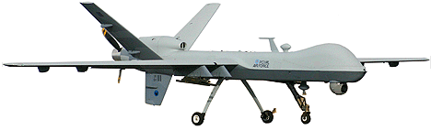
How can they all talk? - BBC
Algorithm designed to solve the problem of jam-resistant communication
Encrypt
Decrypt
Sign
Check Signature
Jam Resistance
Jam Resistance
The Glowworm hash: Increased Speed and Security for BBC Unkeyed Jam Resistance, Baird, Carlisle, Bahn and Smith, MILCOM 2012

Slide 25
New Field of Coding Theory
Error detecting codes: commu!#*(@#*&$
Error correcting codes: commXnicXtion
Concurrent codes: communication
WORD
The Glowworm hash: Increased Speed and Security for BBC Unkeyed Jam Resistance, Baird, Carlisle, Bahn and Smith, MILCOM 2012

Slide 26

Superimposed Images
The Glowworm hash: Increased Speed and Security for BBC Unkeyed Jam Resistance, Baird, Carlisle, Bahn and Smith, MILCOM 2012
Notes:
Four three-letter words that are superimposed. Do you know what they are?

Slide 27
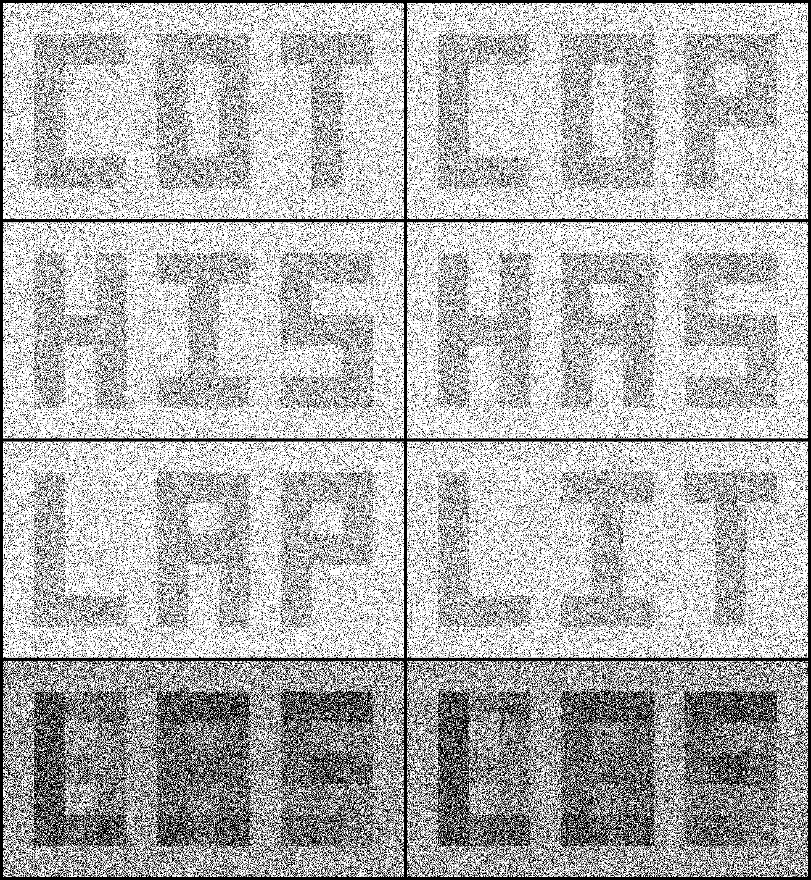
The Glowworm hash: Increased Speed and Security for BBC Unkeyed Jam Resistance, Baird, Carlisle, Bahn and Smith, MILCOM 2012

Slide 28
The Glowworm hash: Increased Speed and Security for BBC Unkeyed Jam Resistance, Baird, Carlisle, Bahn and Smith, MILCOM 2012

Slide 29
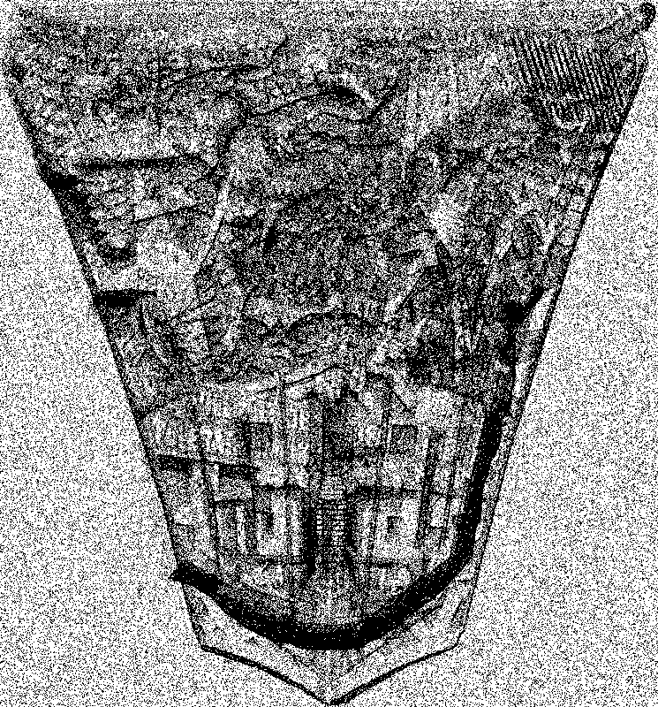

Slide 30



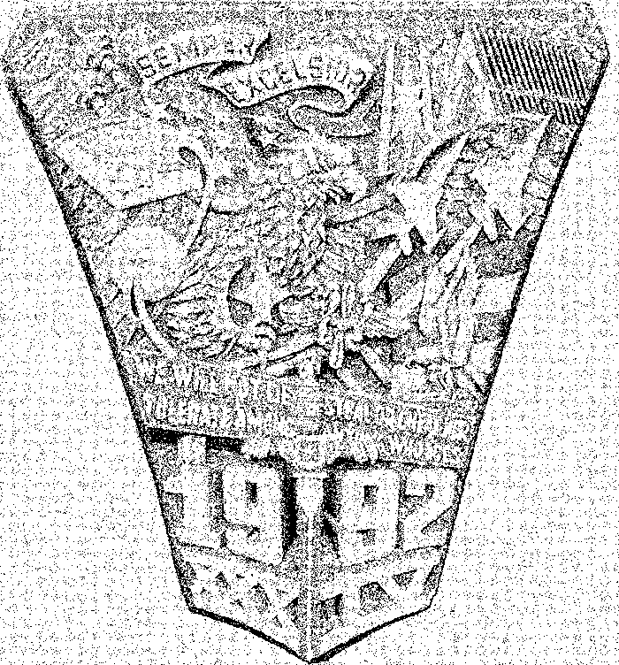

Slide 31
BBC (Using UWB Pulses)
Power
Time
Message: 1011
Append zeros: 101100
Hash prefixes:
1
Hash
10
Hash
101
Hash
BBC also supports CDMA (direct sequence) and frequency hopping
1011
Hash
10110
Hash
101100
Hash
The Glowworm hash: Increased Speed and Security for BBC Unkeyed Jam Resistance, Baird, Carlisle, Bahn and Smith, MILCOM 2012
Notes:
Also works for frequency hopping and spread spectrum, but the picture is clearer with UWB pulses.

Slide 32
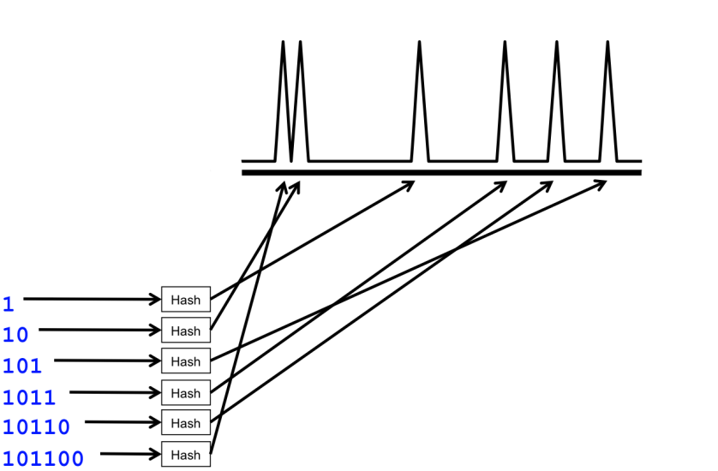
Decoding
0
1
10
11
100
101
110
111
1000
1001
1010
1011
1110
1111
10000
10110
11100
100000
101100
The Glowworm hash: Increased Speed and Security for BBC Unkeyed Jam Resistance, Baird, Carlisle, Bahn and Smith, MILCOM 2012

Slide 33
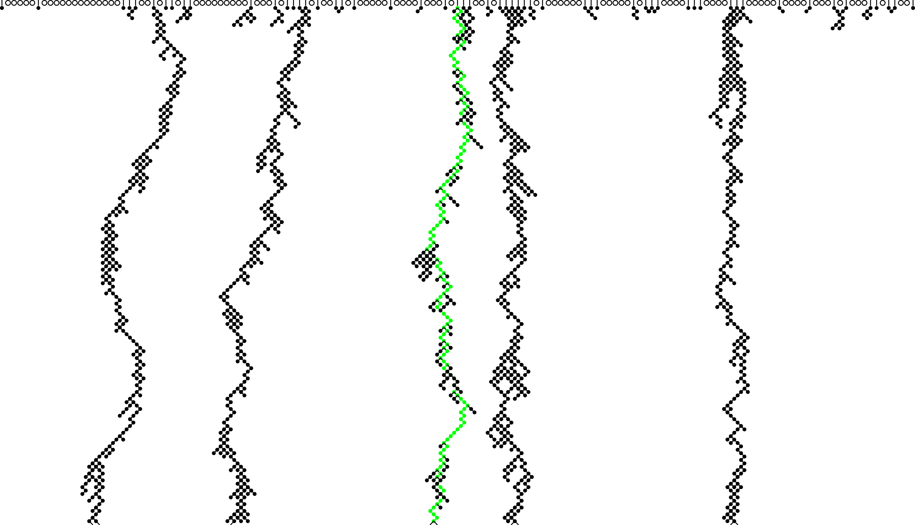
Decode Tree – 5 Messages, 1/3 Mark Density

Slide 34

BBC - Glowworm
Incredibly fast hash
  11 clock cycles per string
  1 cycle per hash in FPGA
Indistinguishable from all five SHA-3 finalists using Cramer-von Mises test
The Glowworm hash: Increased Speed and Security for BBC Unkeyed Jam Resistance, Baird, Carlisle, Bahn and Smith, MILCOM 2012

Slide 35
How do we secure them?
Lots of work needed here!

Slide 36
Internet of Things
DEFCON 2016
47 vulnerabilities in 23 IOT devices
  Smart door locks
  Padlocks
  Thermostats
  Refrigerators
  Wheelchairs
  Solar panel arrays
Notes:
http://www.csoonline.com/article/3119765/security/hackers-found-47-new-vulnerabilities-in-23-iot-devices-at-def-con.html

Slide 37
Oct 2016 DDoS on Internet
500,000 DVRs involved in Mirai botnet
https://www.dynstatus.com/incidents/nlr4yrr162t8
“Investigating
Starting at 11:10 UTC on October 21st-Friday 2016 we began monitoring and mitigating a DDoS attack against our Dyn Managed DNS infrastructure. Some customers may experience increased DNS query latency and delayed zone propagation during this time. Updates will be posted as information becomes available. ”
By attacking DNS, prevented users from getting to websites without attacking the websites themselves.
Main culprit – default username/passwords
2) Created by three people!
Notes:
It was three Minecraft playing college kids running a profitable Minecraft server who wanted to blast competing Minecraft hosting servers off the Net in order to obtain their competitors' user bases.
http://www.popularmechanics.com/technology/infrastructure/a23504/mirai-botnet-internet-of-things-ddos-attack/
https://github.com/jgamblin/Mirai-Source-Code
http://www.popularmechanics.com/technology/infrastructure/a23482/dyn-ddos-attacks/
https://www.dynstatus.com/incidents/nlr4yrr162t8

Slide 38
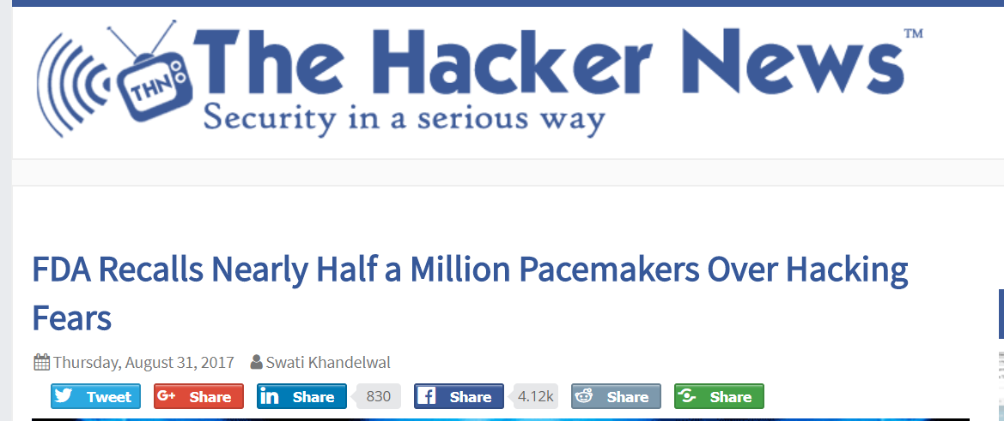
The Internet of (unsafe) Things?

Slide 39
Formal Methods - VigNAT
Formally Verify a stateful network device (Network Address Translation) with competitive performance and reasonable human effort
Arseniy Zaostrovnykh, Solal Pirelli, Luis Pedrosa, Katerina Argyraki, and George Candea. 2017. A Formally Verified NAT. In Proceedings of the Conference of the ACM Special Interest Group on Data Communication (SIGCOMM '17).

Slide 40
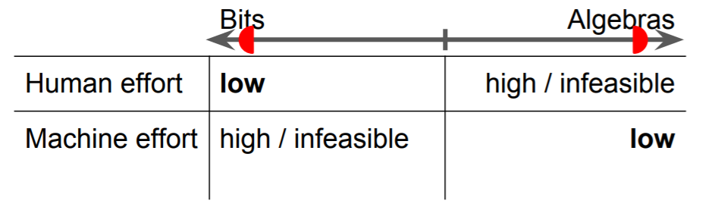
Formal Methods - VigNAT
Key ideas:
  Testing is cheap but leaves bugs
  Symbolic execution and formal algebras are infeasible– combine them!
Arseniy Zaostrovnykh, Solal Pirelli, Luis Pedrosa, Katerina Argyraki, and George Candea. 2017. A Formally Verified NAT. In Proceedings of the Conference of the ACM Special Interest Group on Data Communication (SIGCOMM '17).

Slide 41
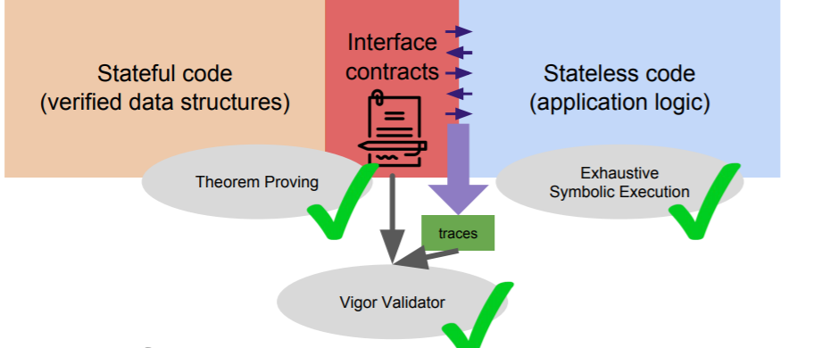
Formal Methods - VigNAT
Arseniy Zaostrovnykh, Solal Pirelli, Luis Pedrosa, Katerina Argyraki, and George Candea. 2017. A Formally Verified NAT. In Proceedings of the Conference of the ACM Special Interest Group on Data Communication (SIGCOMM '17).

Slide 42
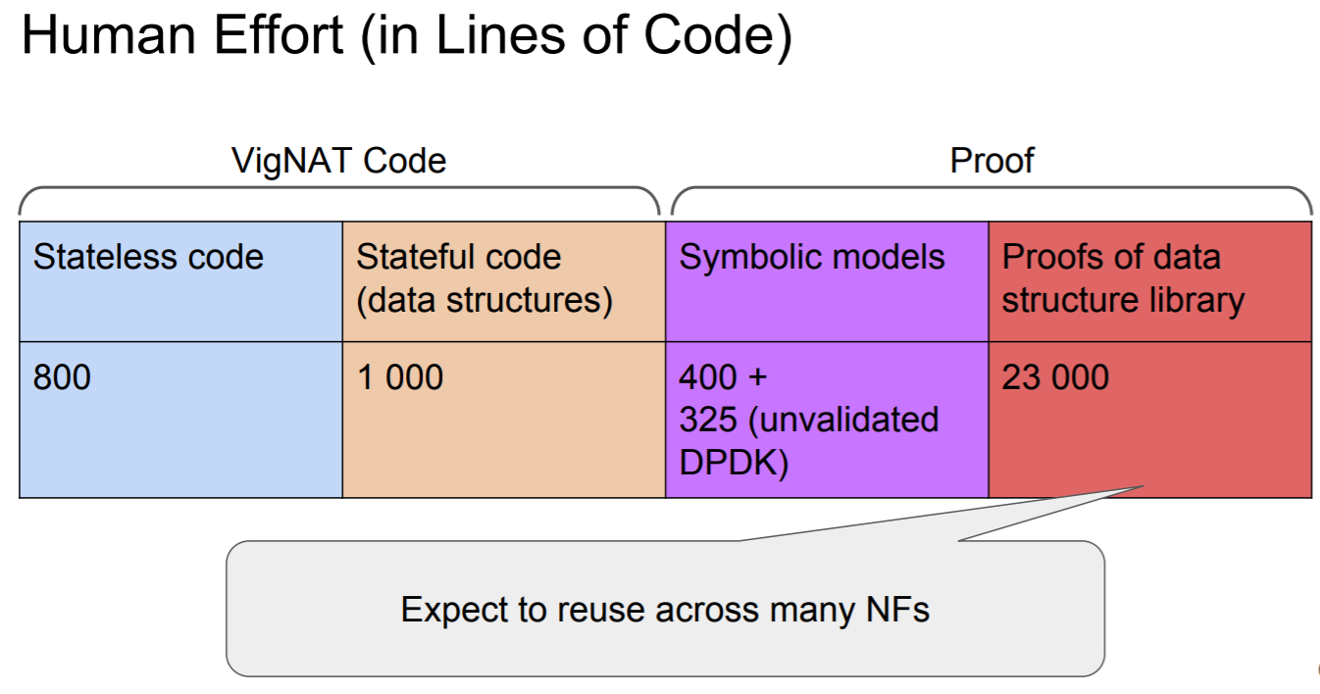
Formal Methods - VigNAT
Arseniy Zaostrovnykh, Solal Pirelli, Luis Pedrosa, Katerina Argyraki, and George Candea. 2017. A Formally Verified NAT. In Proceedings of the Conference of the ACM Special Interest Group on Data Communication (SIGCOMM '17).

Slide 43
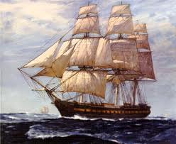
Formal Methods - Ironsides
Create a DNS server that can be proven free of top security vulnerabilities
Key idea: proving correctness is hard, so prove data-flow and exception free instead
“IRONSIDES: DNS With No Single-Packet Denial of Service or Remote Code Execution Vulnerabilities,” Martin Carlisle and Barry Fagin, Proceedings of IEEE GLOBECOM, December 2012.

Slide 44
Proven Security Properties - IRONSIDES
NO:
  Classic Buffer Overflow
  Incorrect calculation of buffer size
  Improper initialization
  Ineffective statements
  Integer overflow/wraparound
  Information leakage
  Unvalidated input
Notes:
We get 9 more for free as they aren’t relevant to DNS or compiled languages

Slide 45
Proven Security Properties – IRONSIDES (2)
NO:
  Allocation w/o limits (resource exhaustion)
  Improper array indexing
  Null pointer dereferencing
  Expired pointer dereferencing (use after free)
  Type confusion
  Race conditions
  Incorrect conversions
  Uncontrolled format strings
Notes:
We get 9 more for free as they aren’t relevant to DNS or compiled languages

Slide 46
Proven Security Properties – IRONSIDES (3)
All loops guaranteed to terminate!
Notes:
We get 9 more for free as they aren’t relevant to DNS or compiled languages

Slide 47
Beware the AIs!
Adversarial machine learning seeks to take a trained AI and fool it, while making the difference imperceptible to humans

Slide 48
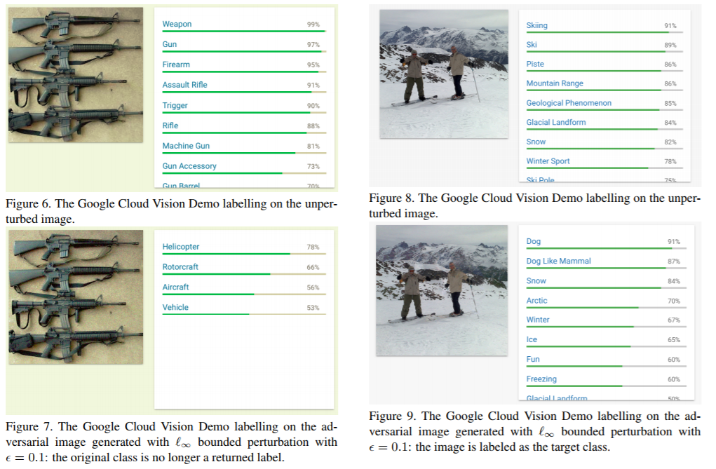
Adversarial Machine Learning
https://arxiv.org/pdf/1712.07113.pdf
Notes:
Query-efficient Black-box Adversarial Examples MIT Dec 2017

Slide 49
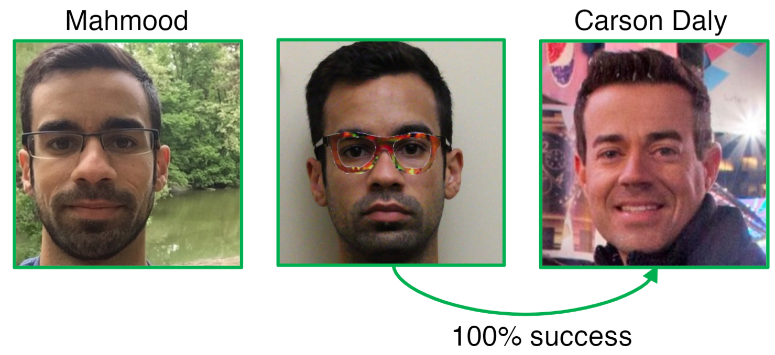
But can we do this in the real world?
"Accessorize to a Crime: Real and Stealthy Attacks on State-of-the-Art Face Recognition", Sharif et al., CCS '16

Slide 50
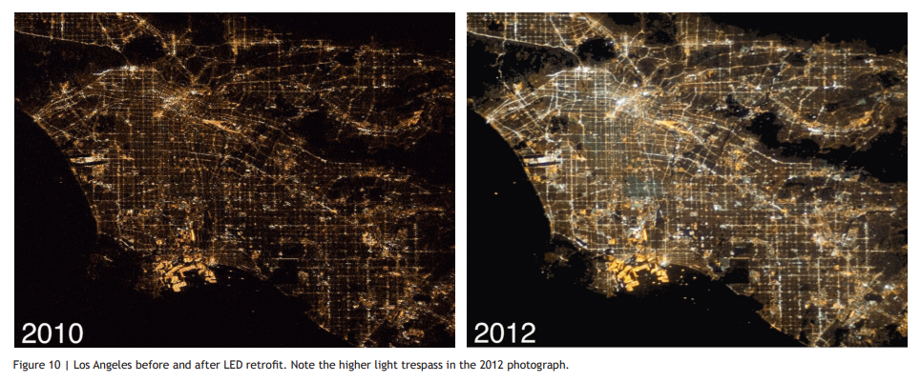
Other Unintended Consequences
http://repository.cmu.edu/cgi/viewcontent.cgi?article=1120&context=architecture

Slide 51
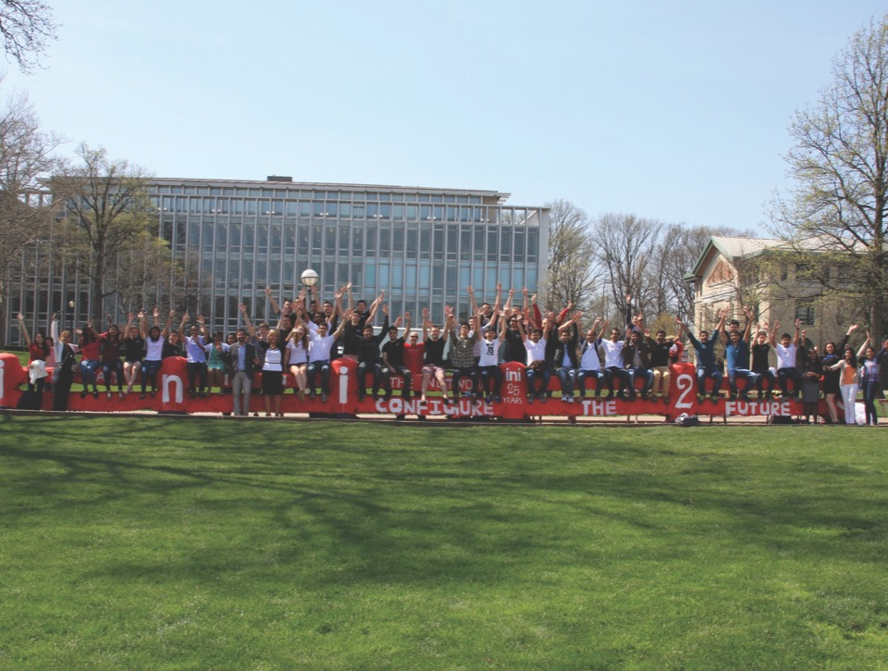
Discussion

